Slide 1
Integrity constraints

Slide 2
Need of integrity constraint
Many user enter data in database and it is very
important that the data item & association among them never destroy.
Therefore Data insertion ,updating& other processes have to be perform in such a way that data integrity is not affected .
For this integrity checks are made at data level by checking the value to certain specify rule.

Slide 3
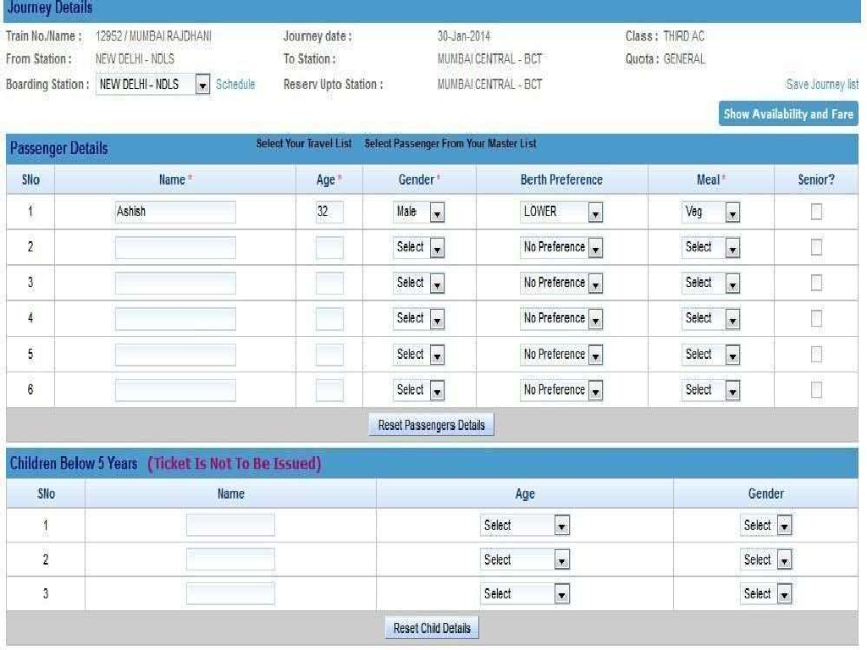

Slide 4





Entity
Referential
Domain
Integrity Constraints

Slide 5











Domain integrity means the definition of a valid set of values for an attribute. You define
data type,
length or size
is null value allowed
is the value unique or not
for an attribute.
The range (values in between) and/or specific values for the attribute. Some DBMS allow you to define the output format and/or input mask for the attributes.

Slide 6



Varchar
Integer
Character
Emp_ID | ADD | Phone No. | Age | Name
X1 | VBN | 111 | 21 | A
X2 | MTR | 123 | 23 | E
X3 | MUB | 432 | 22 | D
(Age>=18)

Slide 7


The entity integrity constraint states that primary
keys can't be null.
On the other hand, there can be null values other than primary key fields. Null value is different from zero value or space.
The entity integrity constraints assure that a specific row in a table can be identified.

Slide 8


REG.NO | MODEL_id | RATE
ABC-112 | 1 | 45,00$
ACC-223 | 6 | 65,00$
BAA-441 | 2 | 57,00$
NULL | 5 | 35,00$
CCE-325 | 3 | 45,00$
CCE-326 | 4 | 61,00$
Null value not allowed

Slide 9
The referential integrity constraint is specified between two tables and it is used to maintain the consistency among rows between the two tables.
The rules are:
You can't delete a record from a primary table if matching records exist in a related table.
You can't change a primary key value in the primary table if that record has related records.
You can't enter a value in the foreign key field of the related table
that doesn't exist in the primary key of the primary table.
However, you can enter a Null value in the foreign key, specifying that the records are unrelated.

Slide 10


Example of referential
REG.NO | MODEL_id | RATE
ABC-112 | 1 | 45,00$
ACC-223 | 6 | 65,00$
BAA-441 | 2 | 57,00$
BSA-224 | 5 | 35,00$
CCE-325 | 3 | 45,00$
CCE-326 | 4 | 61,00$
Model_id | Mark | Model
1. | ford | focus
2. | ford | mondeo
3. | Peugeot | 307
4. | Peugeot | 407
Primary table
Related table

Slide 11

Foreign Key Integrity Constraint
There are two type foreign key integrity constraints:
cascade update related fields
cascade delete related rows.
These constraints affect the referential integrity constraint.

Slide 12
I. Cascade Update Related Fields
Any time you change the primary key of a row in the primary table, the foreign key values are updated in the matching rows in the related table.
This constraint overrules rule 2 in the referential integrity constraints.

Slide 13
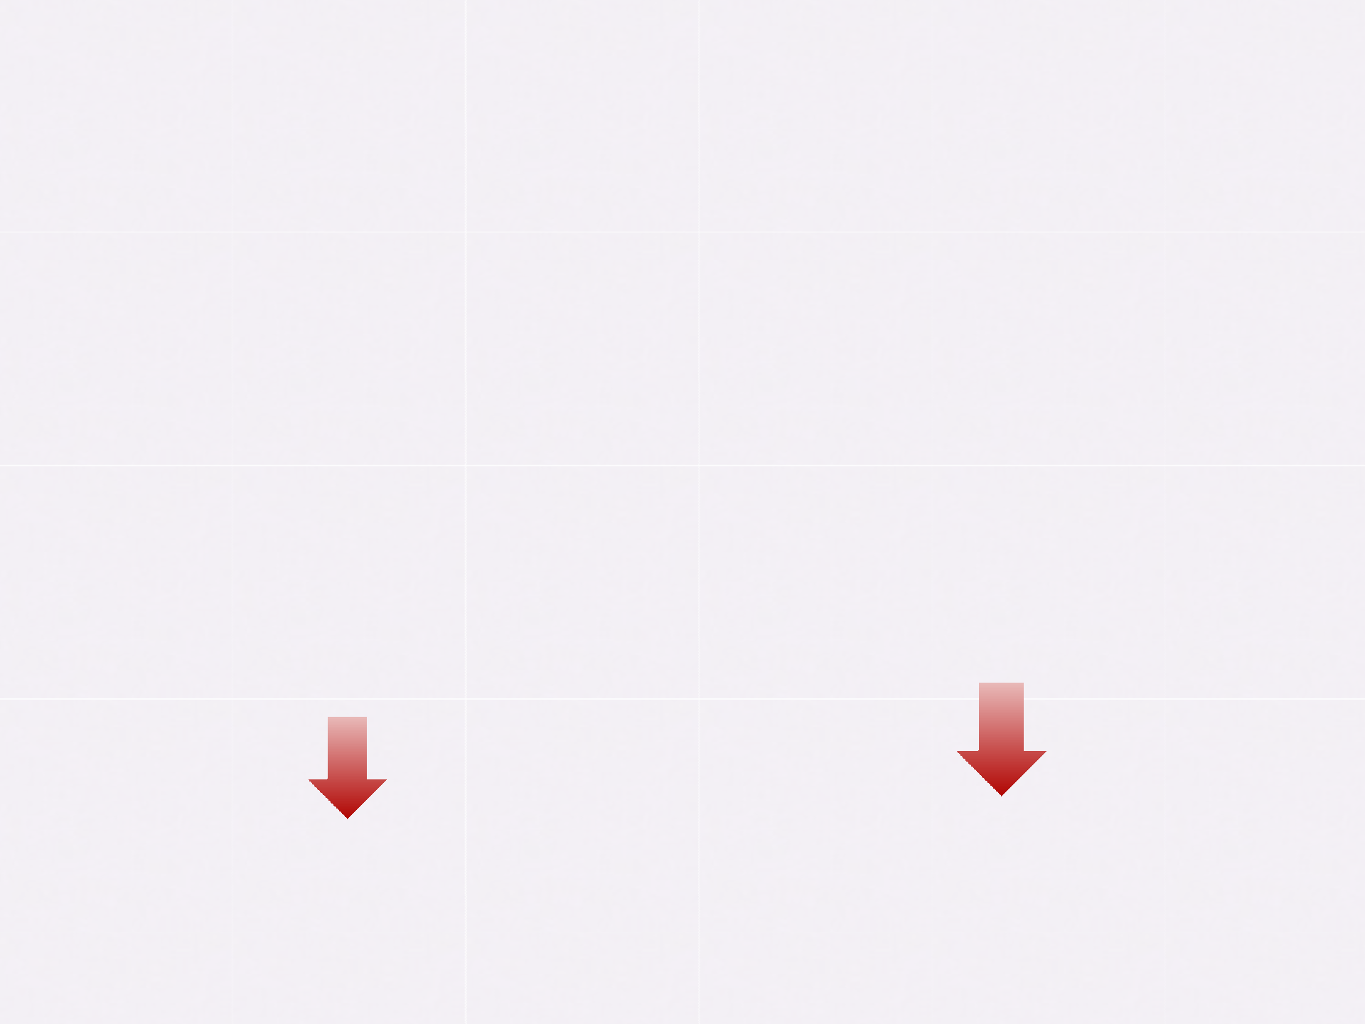

Example of Cascade Update Related Fields
REG.NO | MODEL_i d | RATE
ABC-112 | 1 | 45,00$
ACC-223 | 2 | 65,00$
BAA-441 | 3 | 57,00$
BSA-224 | 7. | 35,00$
CCE-325 | 5 | 45,00$
CCE-326 | 6 | 61,00$
REG.NO | Model_i d | Mark | Model
ABC-112 | 1. | ford | focus
ACC-223 | 2. | ford | mondeo
BAA-441 | 3. | Peugeot | 307
BSA-224 | 7. | Peugeot | 407
4
4.
Primary table
Related table

Slide 14
II. Cascade Delete Related Rows
Any time you delete a row in the primary table, the matching
rows are automatically deleted in the related table.
This constraint overrules rule 1 in the referential integrity

Slide 15
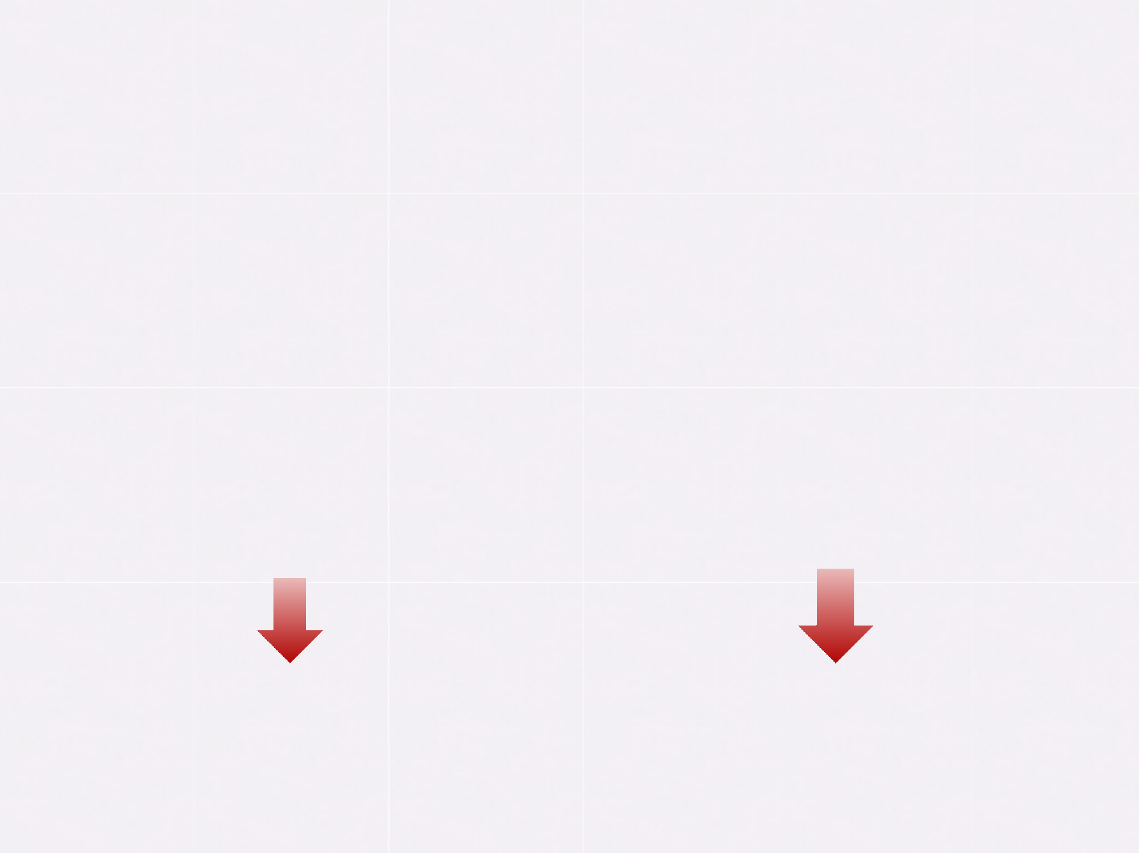

Example of Cascade Delete Related Rows
REG.NO
MODEL_i RATE
d
1 45,00$
2 65,00$
REG.NO | Model_i d | Mark | Model
ABC-112 | 1. | ford | focus
ACC-223 | 2. | ford | mondeo
BAA-441 | 3. | Peugeot | 307
ABC-112
ACC-223
BAA-441 | 3 | 57,00$
CCE-325 | 5 | 45,00$
CCE-326 | 6 | 61,00$
BSA-224 4 35,00$
BSA-224 4. 407
Peugeot
Related table
Primary table

Slide 16

S.No. | Name | Age | course | Ph No. | Roll no. | Enroll no.
1 | Amit | 21 | B.Tech | 542312 | 432876 | 234567
2 | Anju | 20 | B.Tech | 543122 | 432873 | 234890
3 | Vijay | 18 | MBA | 543114 | 432098 | 456789
4 | Tarun | 20 | B.Tech | 765432 | 432876 | 456789
5 | Sita | 19 | BBA | 987654 | 567483 | 987543
6 | Rita | 19 | BCA | 123456 | 432878 | 123456
7 | Dinesh | 20 | B.Tech | 765434 | 547894 | 456789
432098
NUL3
7. Dinesh 20 B.tech. 765434 547894 456789
(Age => 18)
Domain Constraint

Slide 17
Thank You!

